Slide 1
Welfare collaboration in Norway: Something old, something new, something borrowed, something to pursue?
Dissertation for the degree of philosophiae doctor (PhD) at the Faculty of Social Sciences, University of Bergen
Date: 11.05.2023

Slide 2
The Ph.D. Project
Employed at the Western Norway University of Applied Sciences
Ph.D. Program at the Faculty of Social Sciences, University of Bergen
Supervisor: Prof. Jacob Aars

Slide 3
Background and motivation
Modern welfare state have faced growing demands for public sector innovation
New forms of collaboration have emerged as global ideas for how to innovate the public sector
New forms of collaboration studied in the thesis
Social enterprise
Collaborative innovation project

Slide 4
Research problem and study context
How are global ideas adapted by modern welfare states? How might welfare state models affect the adaptation?
Study context: The Nordic Welfare Model (Norway)
Two competing legacies:
Legacy of cooperation
Legacy of statism

Slide 5
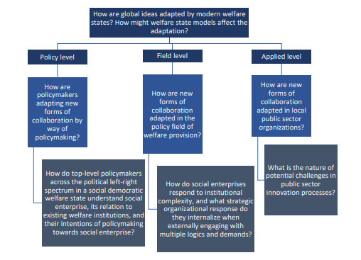
Research problem and study context (cont.)
Complementary analytical approach (Roness, 1997:89)

Slide 6
Theoretical framework
Neo-institutionalist approach as the overarching framework
Highlights contextual features
Translation theory
Scandinavian institutionalist approach
Actor-Network-Theory (ANT) approach
Path dependence and gradual institutional change

Slide 7
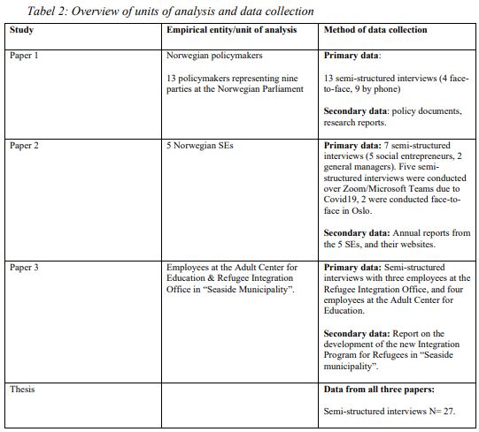
Methods
Exploratory research design
Semi-structured interviews
Strategical and purposefully sampling
Limitations:
Jk

Slide 8
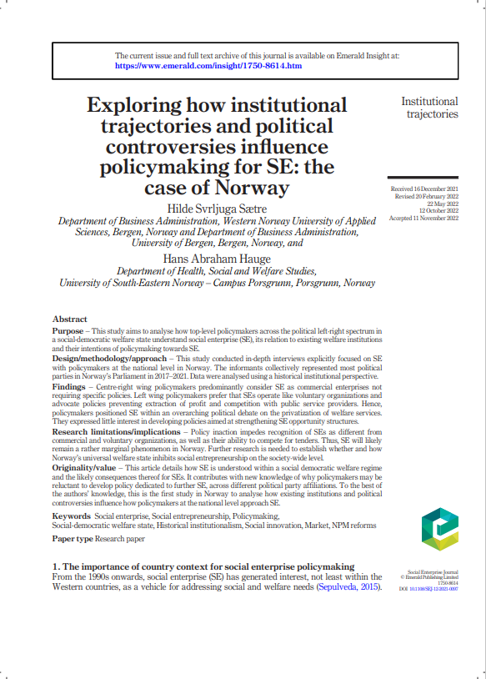
Article 1
Policy level: how policymakers are adapting new forms of collaboration by way of policymaking
RQ: How do top-level policymakers across the political left-right spectrum of the social democratic welfare state understand social enterprise, its relation to existing welfare institutions, and their intentions of policymaking towards social enterprise?
Explore why policymakers in Norway has chosen inaction over action in policymaking.
Co-author: Assoc. Prof. Hans Abraham Hauge (USN)
Published in Social Enterprise Journal (2023)

Slide 9
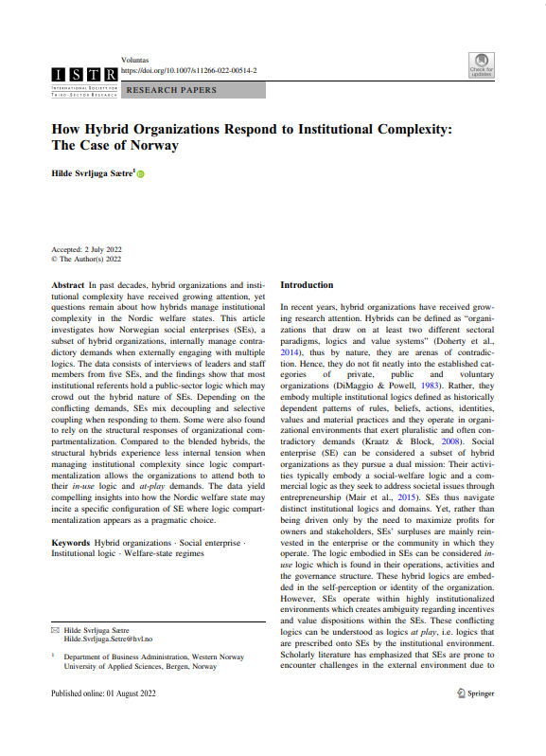
Article 2
Field level: how are social enterprise adapted into the field of welfare provision
RQ: how do social enterprises respond to institutional complexity, and what strategic organizational responses do they internalize when externally engaging with multiple logics and demands?
Published in VOLUNTAS – International Journal of Voluntary and Nonprofit organizations (2022)

Slide 10
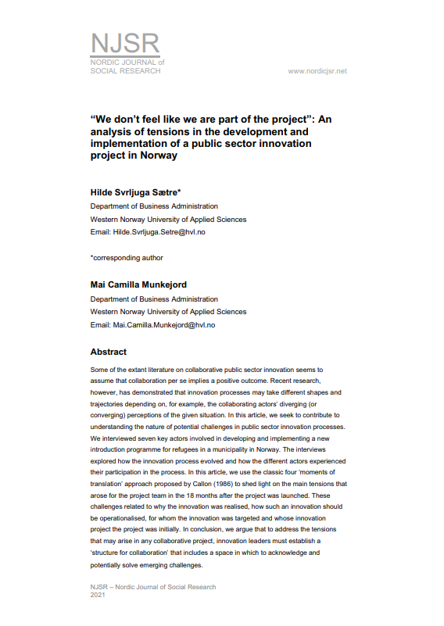
Article 3
Applied level: how are new forms of collaboration adapted in local public sector organizations?
Collaborative innovation project between two public sector organizations
New Introduction for Refugees that employed a social enterprise as integration vehicle
RQ: What is the nature of potential challenges facing public sector innovation processes?
Co-author: Mai Camilla Munkejord
Published in Nordic Journal of Social Research (2021)

Slide 11
Findings
Overall findings
Adaptation of global ideas in new context is a complex process
In the hands of many actors at different levels
Institutional factors play an important role
Article-specific findings
Policymakers opt for inaction because social enterprise is viewed in relation to the existing sytem of welfare
Social enterprises employ different strategies to secure compliance with internal and external logics
When developing and implementing collaborative innovation project – important to discuss and agree

Slide 12
Contributions
Empirical
Practical
Theoretical

Slide 13
Thank you for your attention

