Slide 1
to be an Atlantic salmon
What is it like
?
Jarl Giske, salmon workshop, Bergen Nov 2022

Slide 2
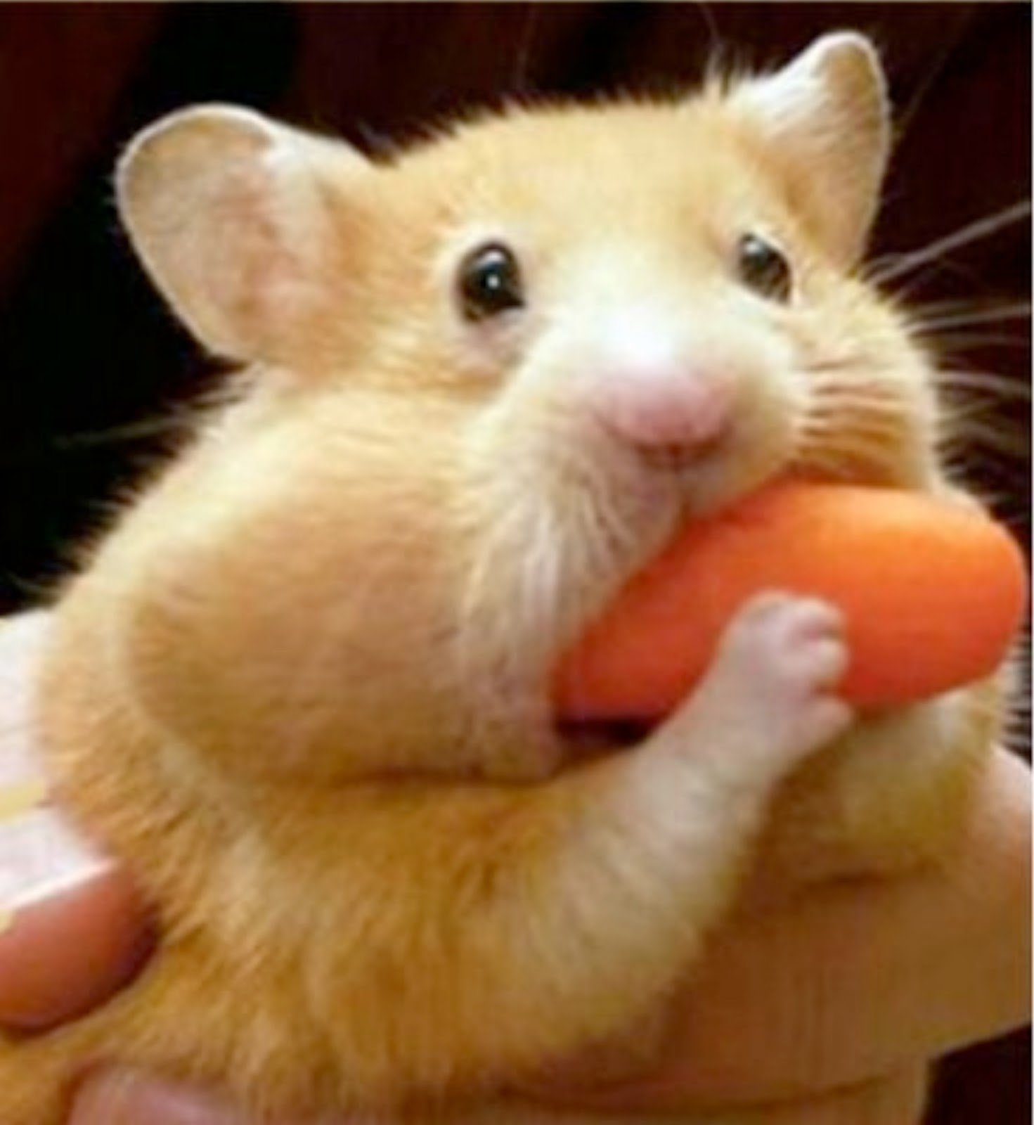
3 good reasons to study this
What is it like to be an Atlantic salmon?
To understand better what it is to be an animal
To advance the theory of animal behaviour
To facilitate responsible (and profitable) aquaculture
“don’t be shy!”

Slide 3
And why study this in salmon?
What is it like to be an Atlantic salmon?
Since a teleost fish is cognitively moderately complex.
Since we know a lot about fish and salmon.
Since good grant proposals can be funded.
To facilitate responsible (and profitable) salmon aquaculture.

Slide 4
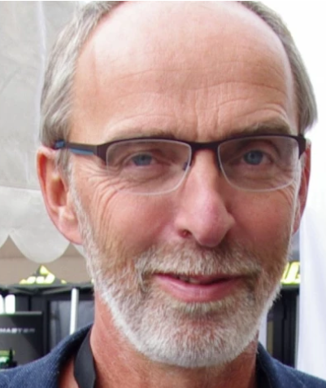
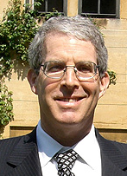
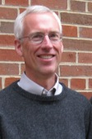
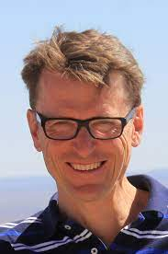
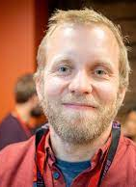
And why should you study this in salmon?
Magda is a psychologist working on consciousness.
Andy is a theoretical behavioural ecologist in a psychology department.
Tore is the leader of the IMR fish welfare research group.
Marc is a theoretical ecologist with a strong interest in salmon.
Anders is a marine ecologist and future salmon modeller.
Steve is a salmon/trout modeler who has become a theoretical ecologist.
Ivar is a fish physiologist with a strong interest in salmon.
Knut is a fish ecologist with much experience in salmon.
Sergey is fluid in animal personalities, Fortran, ecology, behaviour and cognitive sciences.
Katja is a fisheries professor with a special interest (in teaching and research) in sustainability and the UN Agenda 2030.

Slide 5
Can we write an article about what is it like to be an Atlantic salmon?
Or do we have to write 3?
Or 11?
These are the things we must discuss, in between the discussions about what it is to be a salmon.
And now comes my perspective…

Slide 6
3 good reasons to study this
What is it like to be an Atlantic salmon?
To understand better what it is to be an animal
To advance the theory of animal behaviour
To facilitate responsible (and profitable) aquaculture
animal welfare
robust fish
animal wellbeing

Slide 7
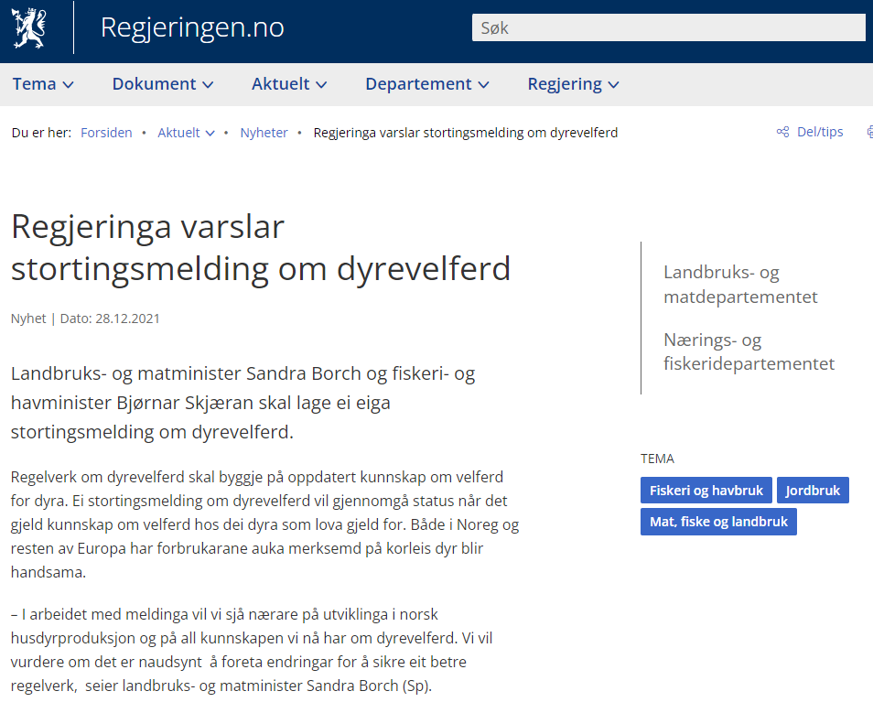
https://www.regjeringen.no/no/aktuelt/regjeringa-varslar-stortingsmelding-om-dyrevelferd/id2893630/
The government announces a parliamentary report on animal welfare
“Animal welfare regulations must be based on up-to-date knowledge of animal welfare. A notification to the Parliament on animal welfare will review the status when it comes to knowledge about the welfare of the animals to which the law applies. Both in Norway and the rest of Europe, consumers have increased attention to how animals are handled.”

Slide 8
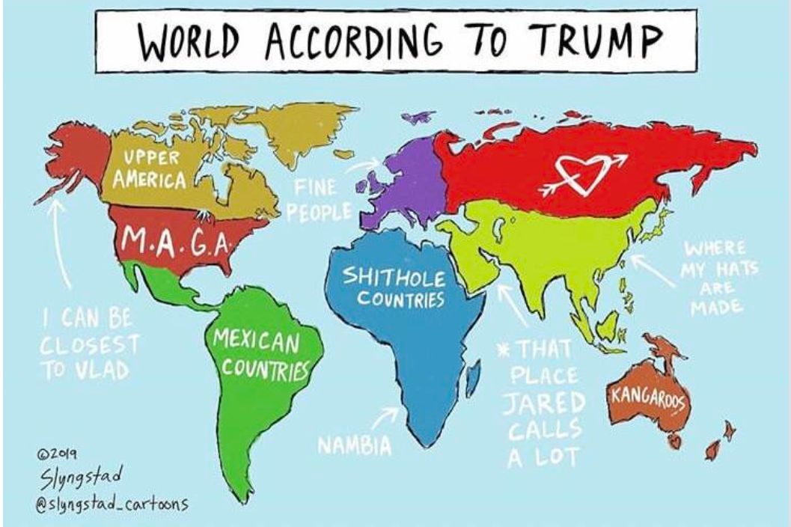
But how is the world according to a salmon?

Slide 9
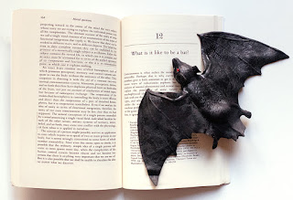
3 good reasons to study this
What is it like to be an Atlantic salmon?
In so far as I can imagine this (which is not very far), it tells me only what it would be like for me to behave as a bat behaves. But that is not the question. I want to know what it is like for a bat to be a bat.
To understand better what it is to be an animal
To advance the theory of animal behaviour
To facilitate responsible (and profitable) aquaculture
Nagel, T 1974. What is it like to be a bat? The Philosophical Review 83: 435–450. doi:10.2307/2183914

Slide 10
3 good reasons to study this
What is it like to be an Atlantic salmon?
To understand better what it is to be an animal
To advance the theory of animal behaviour
To facilitate responsible (and profitable) aquaculture
I should like to close with a speculative proposal. ...
This should be regarded as a challenge to form new concepts and devise a new method - an objective phenomenology not dependent on empathy or the imagination. Though presumably it would not capture everything, its goal would be to describe, at least in part, the subjective character of experiences in a form comprehensible to beings incapable of having those experiences.
Thomas Nagel (1974)

Slide 11
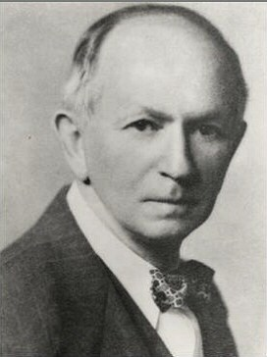
3 good reasons to study this
What is it like to be an Atlantic salmon?
To understand better what it is to be an animal
To advance the theory of animal behaviour
To facilitate responsible (and profitable) aquaculture

Slide 12
Alfred Lotka
Maximizing fitness …
The Euler-Lotka equation
shows how fitness
can be maximized.
… is done through wellbeing.
What guides a human being, for example in the selection of his activities, are his tastes, his desires, his pleasures and pains, actual or prospective.
Lotka AJ 1925. Elements of Physical Biology. Williams & Wilkins Company, p. 460.
Grafen, A 1984. Natural selection, kin selection and group selection, in Behavioural Ecology: An Evolutionary Approach, eds J. R. Krebs and N. B. Davies (Blackwell Publishing), 62–84.
Alfred J. Lotka 1925
“the phenotypic gambit”
Alan Grafen 1984

Slide 13
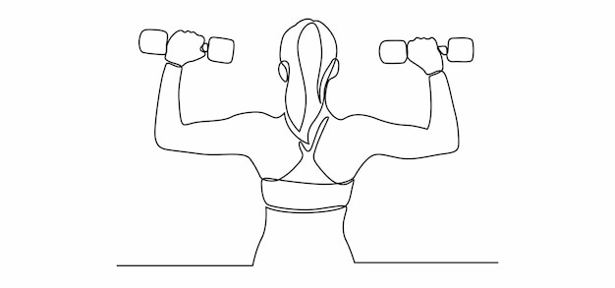
3 good reasons to study this:
What is it like to be an Atlantic salmon?
To advance the theory of animal behaviour
The behaviour of an animal is the result of calculations that try to predict its future wellbeing.
This perspective is very different from the current theories in behavioural ecology.
max (fitness) max (wellbeing)
?
?
?
Bubic A, DY von Cramon & RI Schubotz 2010. Prediction, cognition and the brain. Front Human Neurosci 4:1-15
Clark A 2013. Whatever next? Predictive brains, situated agents, and the future of cognitive science. Behavand Brain Sci 36:181-204

Slide 14
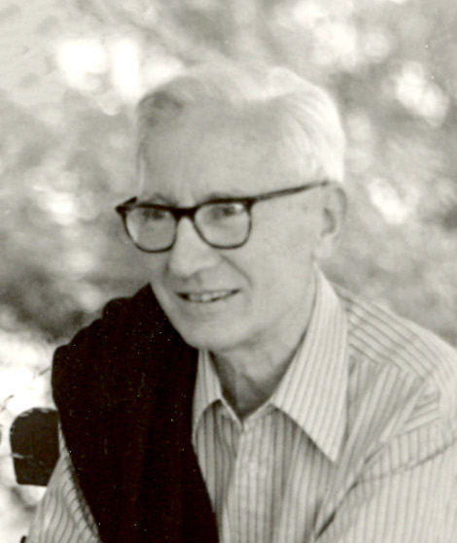
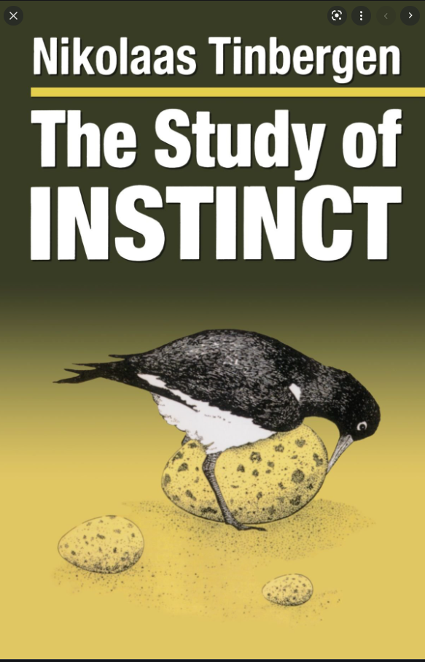
Tinbergen’s four questions
Nesse RM. 2013. Tinbergen’s four questions, organized: a response to Bateson and Laland. TREE 28: 681-682.
Tinbergen N. 1963. On aims and methods in ethology.
Z Tierpsychol 20: 410-433.
1907-1988
Nobel prize in medicine/physiology in 1973.
https://en.wikipedia.org/wiki/Nikolaas_Tinbergen
1951

Slide 15
Nesse RM. 2013. Tinbergen’s four questions, organized: a response to Bateson and Laland. TREE 28: 681-682.
HISTORY
NOW
Animal wellbeing is here.
MECHANISM:
HERE & NOW
As is physiology.
PROXIMATE
ONTOGENY
And we need to be here, also.
ULTIMATE
PHYLOGENY
ADAPTIVE VALUE
The Euler-Lotka equation is here.

Slide 16
What is it like to be a salmon
HISTORY
NOW
here and now?
Ontogeny
Development
Life history
Experiences
Learning
Sensing
Physiology
Hormones
Wellbeing
Cognition
Emotion
Behavior
memory
sensing
PROXIMATE
Wellbeing
emotions
prediction
hormones
Fitness
Agency
Optimality
Constraints
Trade-offs
Phylogeny
Adapted gene pool
Genome
Sex and personality
ULTIMATE
behaviour
agency

Slide 17
The Subjective Internal Model (SIM)
When an animal enters a time step t it already possesses ideas (clues, hints, impressions, awareness, knowledge, …) about itself and the world around it.
Depending on the kind of animal, these ideas can be poor or rich.
These ideas are subjective, as they emerge from the animal’s own experiences.
They are “private”: internal to the animal and not visible to the observer.
Damasio called them an “image” (an imagination), we call them a model.
t - 1
t
t + 1
agency
Budaev S, J Giske & S Eliassen 2018. AHA: A general cognitive architecture for Darwinian agents. Biologically Inspired Cognitive Architectures 25:51-57
Damasio A 2012. Self comes to mind: Constructing the conscious brain. Vintage Books.

Slide 18
The animal must answer two questions:
Context and response
Inside the time step, the animal is bombarded with data. Should it change its mind?
Much of the bombardment is noise, some is irrelevant, some may be important.
But what?
1. What is the proper context?
What is now important and true about the world and myself?
2. What is the proper response?
Which behavioural option would feel best?
t
Hoffmeyer J 2008. Biosemiotics: an examination into the signs of life and the life of signs. Scranton, PA: University of Scranton Press.
Budaev S, C Jørgensen, M Mangel, S Eliassen & J Giske 2019. Decision-making from the animal perspective: Bridging ecology and subjective cognition. Frontiers in Ecology and Evolution 7:164
FitzGerald THB, RJ Dolan & KJ Friston 2014. Model averaging, optimal inferences, and habit formation. Frontiers in Human Neuroscience 8:457
agency

Slide 19
We try to answer them by combining three perspectives
The continuity in world view in the Subjective Internal Model
The competition between survival circuits for control of attention
The search for solutions by the Prediction Machine
?
?
?
t - 1
t
t + 1
Bubic A, DY von Cramon & RI Schubotz 2010. Prediction, cognition and the brain. Front Human Neurosci 4:1-15
Clark A 2013. Whatever next? Predictive brains, situated agents, and the future of cognitive science. Behavand Brain Sci 36:181-204

Slide 20
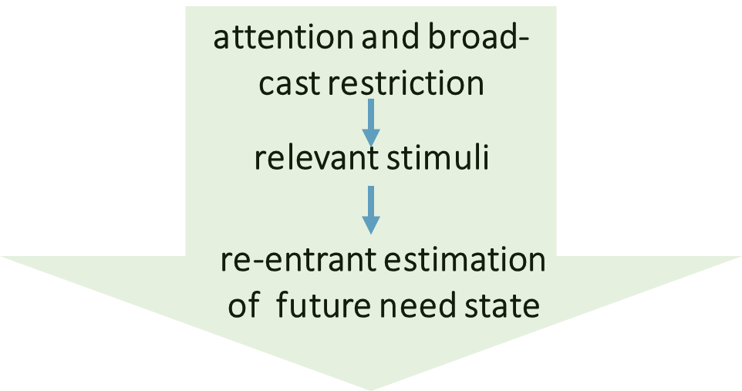
Finding the proper response by imagining emotions
The animal will use its existing neural circuitry to predict what an expected behavioural outcome would feel like.
decision and action
The Predictive Brain
uses the emotion system to evaluate the value of the options available, after proper context is found.
Phylogeny: Evolution by mutations and natural selection will gradually adjust the emotion system and other modules in the survival circuits to produce robust and adaptive behaviour
.
where what feels good
Soylu F 2016. An embodied approach to understanding: making sense of the world through simulated bodily activity. Front Psychol 7:1914
is the proper response
max (fitness) = max (wellbeing)

Slide 21
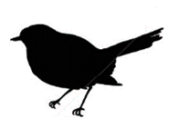
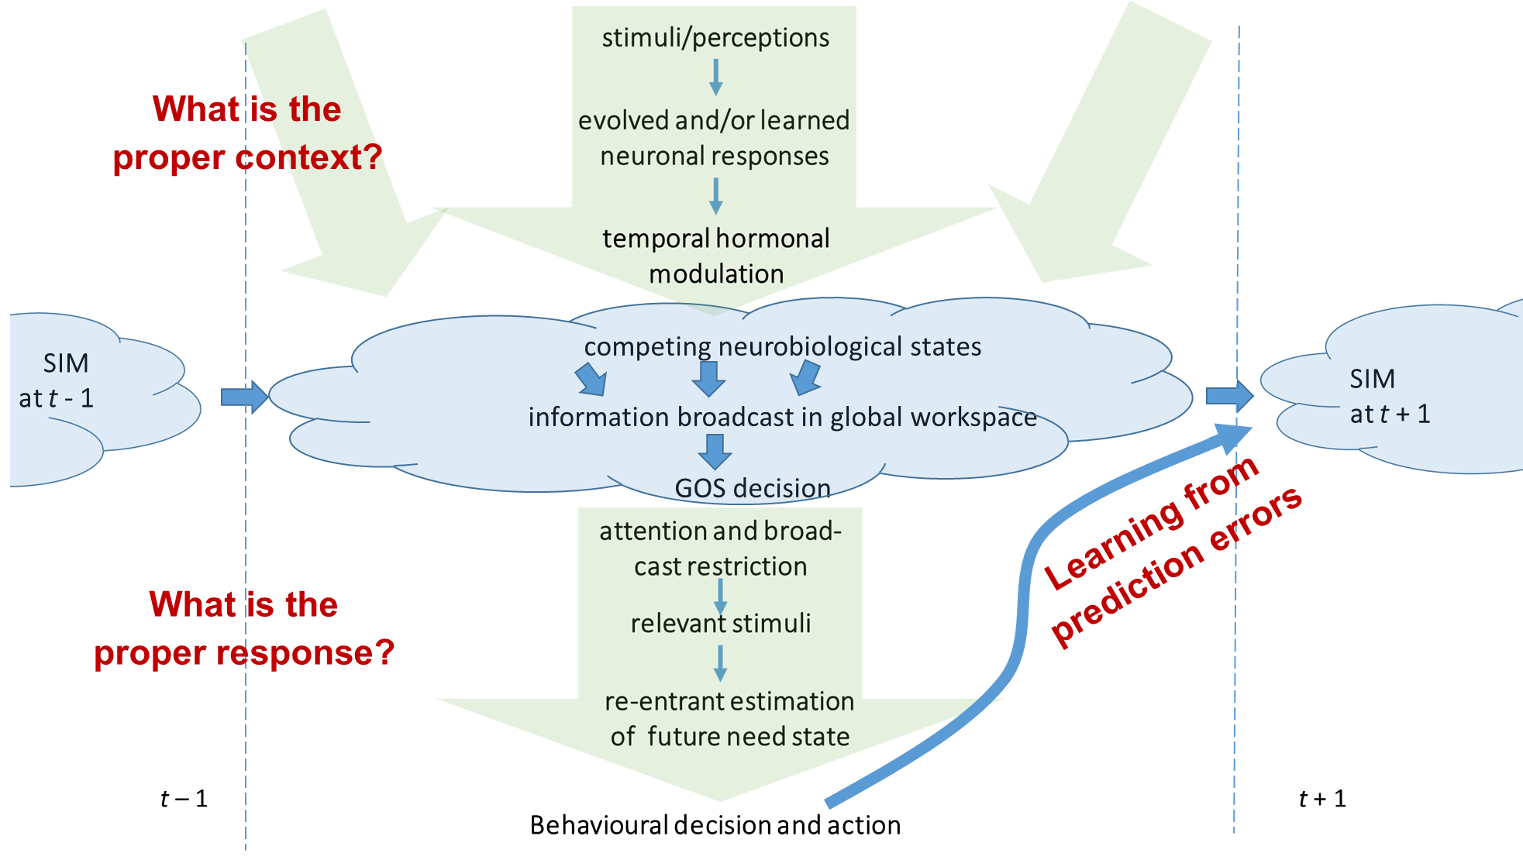
Prediction error: learning from mistakes
?
?
?
Budaev S & al 2020. Computational animal welfare: Towards cognitive architecture models of animal sentience, emotion and wellbeing.
R Soc Open Sci 7:201886

Slide 22
But a fish is more than cognition: hormones!
Weidner J, CH Jensen, J Giske, S Eliassen & C Jørgensen 2020. Hormones as adaptive control systems in juvenile fish. Biol. Open 9:bio046144.
Jensen CH, J Weidner, S Budaev, J Giske, C Jørgensen & S Eliassen 2021. Hormonal adjustments to future expectations impact growth and survival in juvenile fish. Oikos 130:41-51

Slide 23
But a fish is more than cognition: sensing!
It is submerged in a pressure field, with internal and external signals and advanced sensors
Light, sounds, temperature, chemicals….
Giske, J., G. Huse & Ø. Fiksen 1998. Modelling spatial dynamics of fish. Reviews in Fish Biology and Fisheries 8:57-91

Slide 24
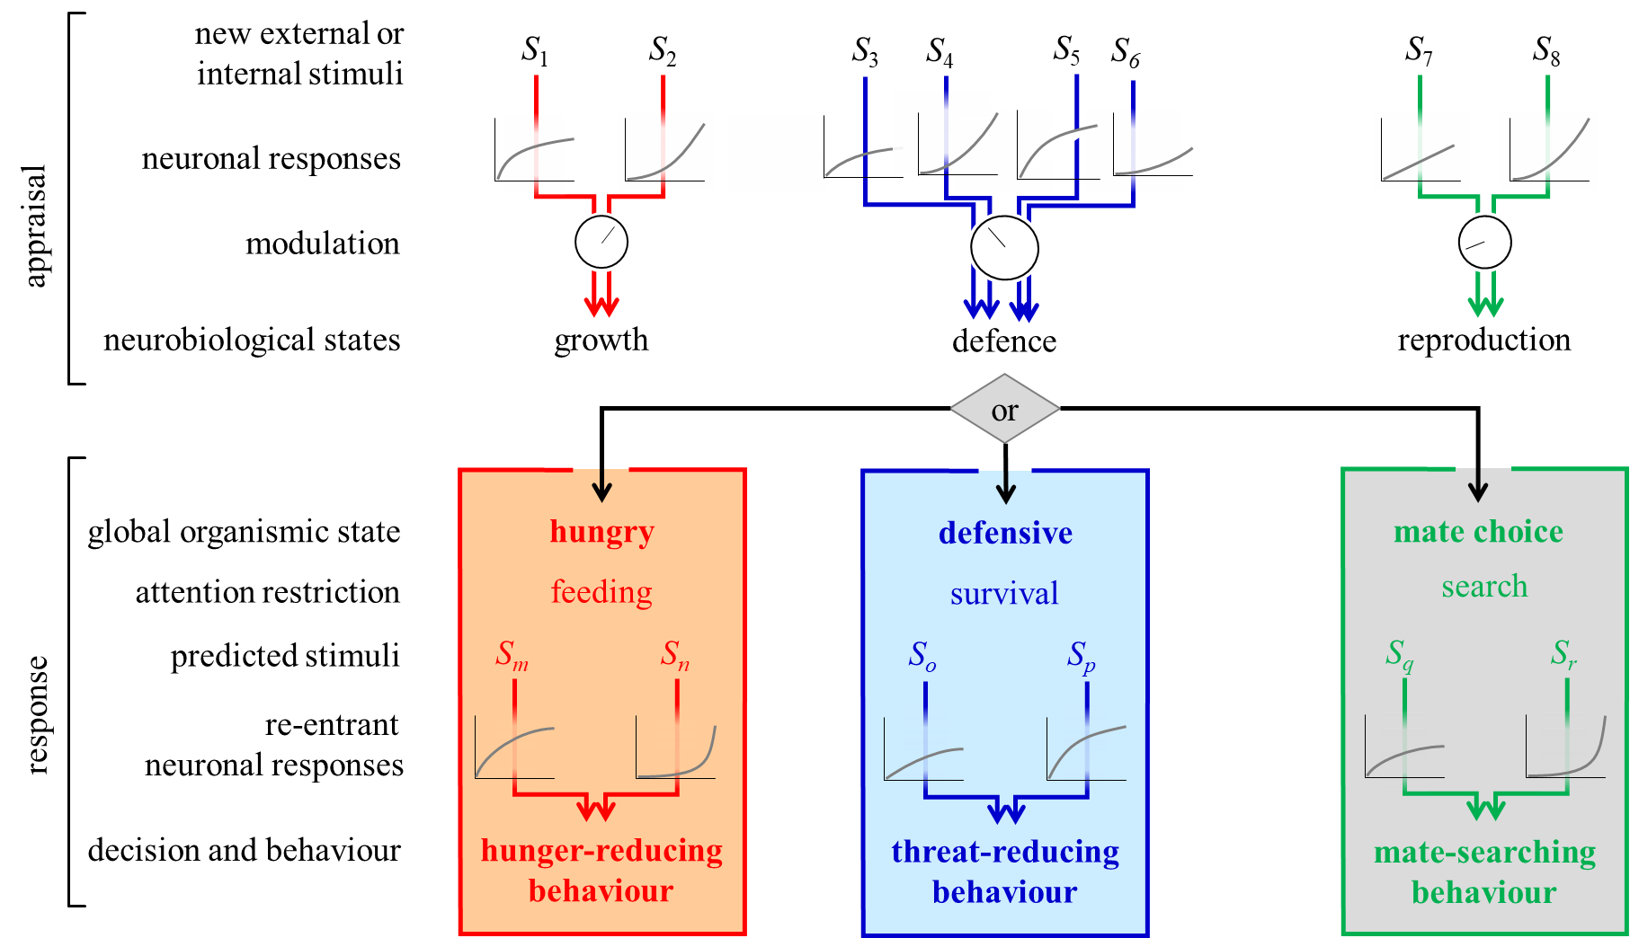
Many survival circuits compete for control of behaviour

Slide 25
3 good reasons to study this
What is it like to be an Atlantic salmon?
To understand better what it is to be an animal
To advance the theory of animal behaviour
To facilitate responsible (and profitable) aquaculture

Slide 26
The Predictive Brain impacts animal welfare
The animal’s response to a stimulus depends on its Global Organismic State.
Several simultaneous pressures may lead to stress.
Uncertainty would increase behavioural heterogeneity, but not at high arousal.
High need state and stress may cause ambiguity bias (avoiding uncertainty).
Budaev S, TS Kristiansen, J Giske & S Eliassen 2020. Computational animal welfare: Towards cognitive architecture models of animal sentience, emotion and wellbeing. R Soc Open Sci 7:201886
?
?
?
t - 1
t + 1

Slide 27
Status report
The predictive brain is constrained by its inherited neuronal circuitry (which may be hardwired to change during ontogeny)
and by lack of experiences stored in the SIM (memory)
and in soft wired circuitry modifications (learning).
It is situational, as the first question is the proper context.
Many researchers have ignored this when planning
an experiment.
Stress is a frequent outcome of the prediction
and an important survival mechanism.

Slide 28
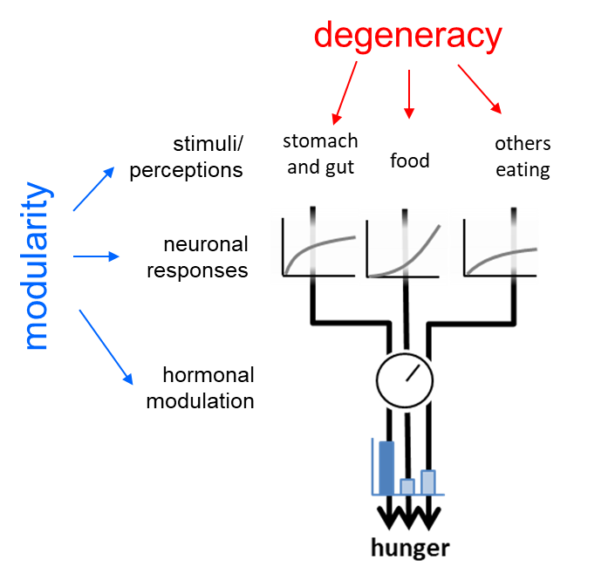
Phil Anderson: More is different
A range of effects
Due to the predictive brain,
decision-making in variable environments becomes better.
Thus, the organism becomes more robust
and less predictable
and more stressed.
Anderson PW 1972. More is different—Broken symmetry and nature of hierarchical structure of science. Science 177:393–396
28

