Slide 1
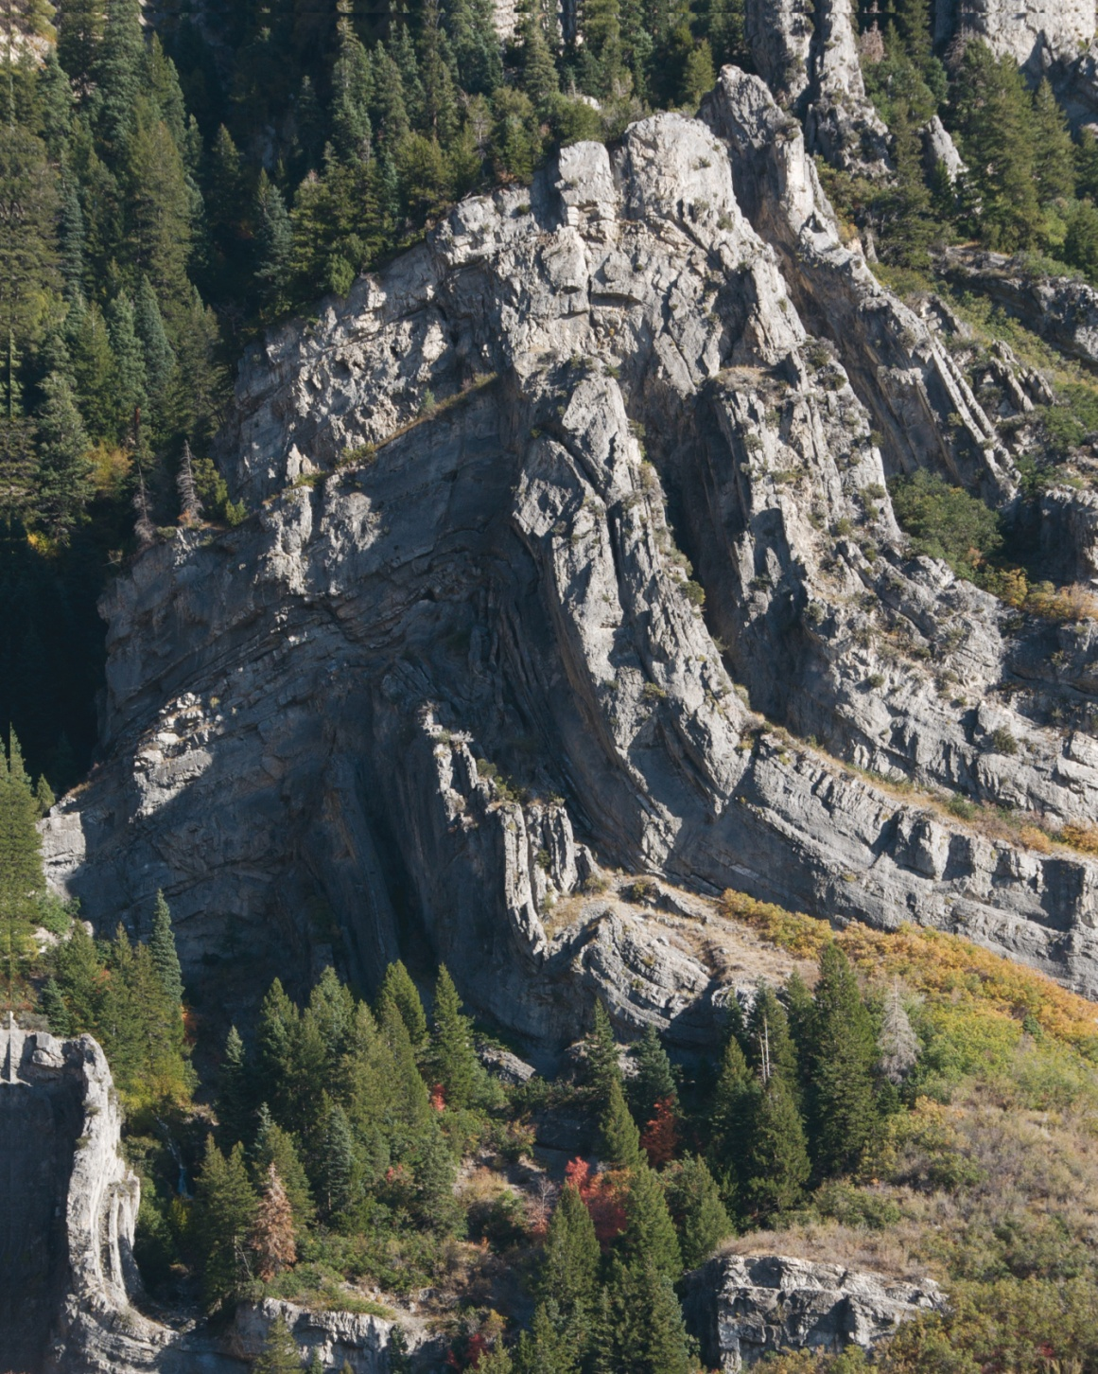
© Cambridge University Press 2011

Slide 2
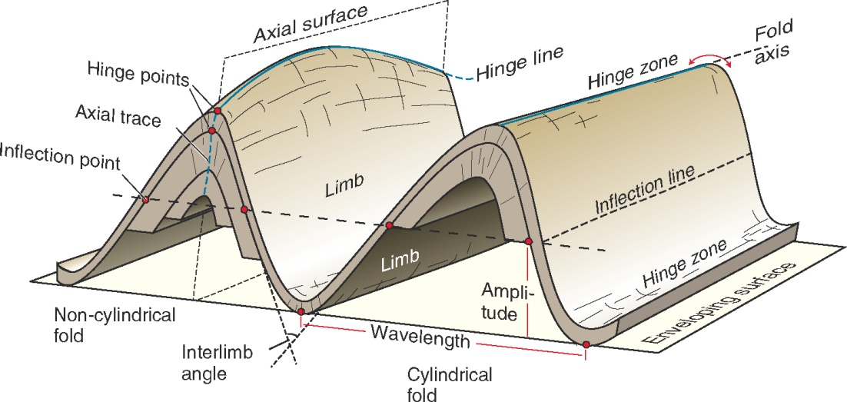
© Cambridge University Press 2011

Slide 3
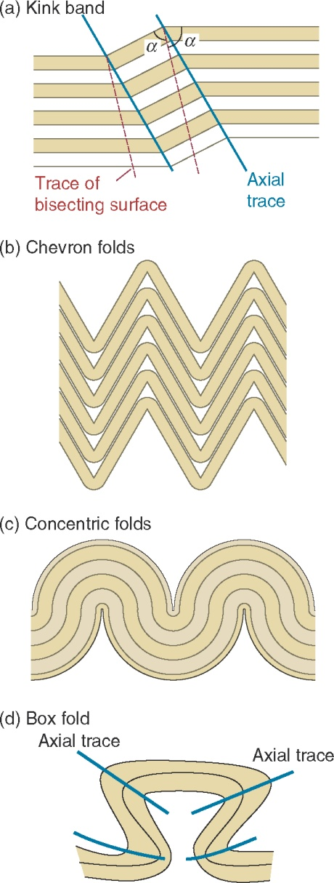
© Cambridge University Press 2011

Slide 4
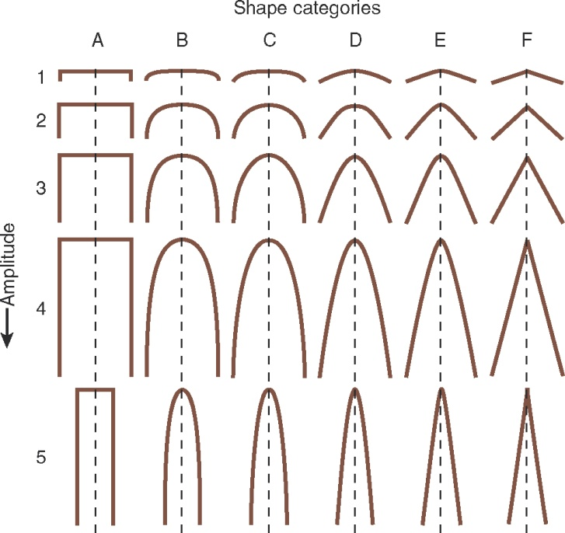
© Cambridge University Press 2011

Slide 5
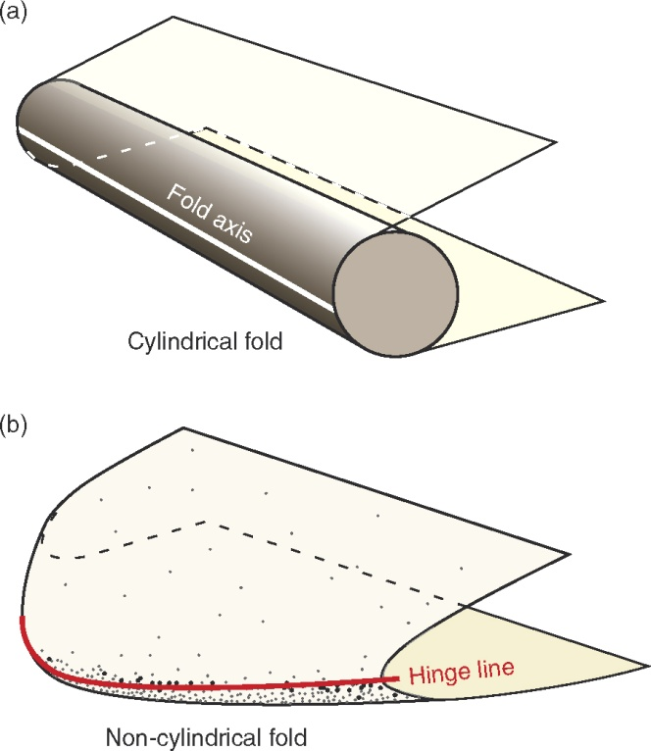
© Cambridge University Press 2011

Slide 6
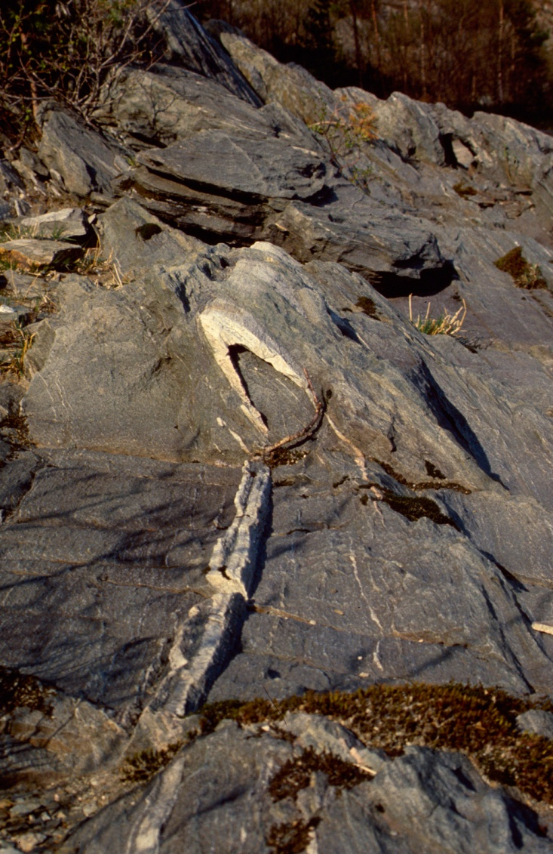
© Cambridge University Press 2011

Slide 7
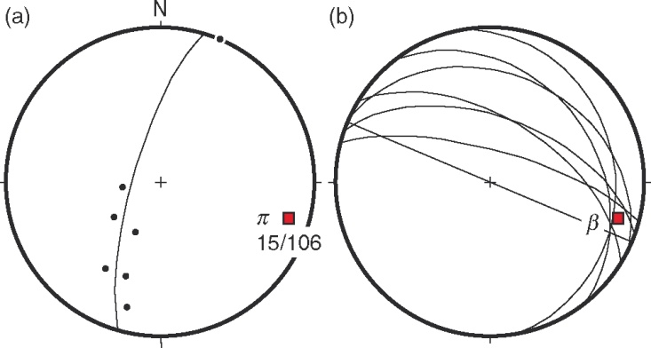
© Cambridge University Press 2011

Slide 8
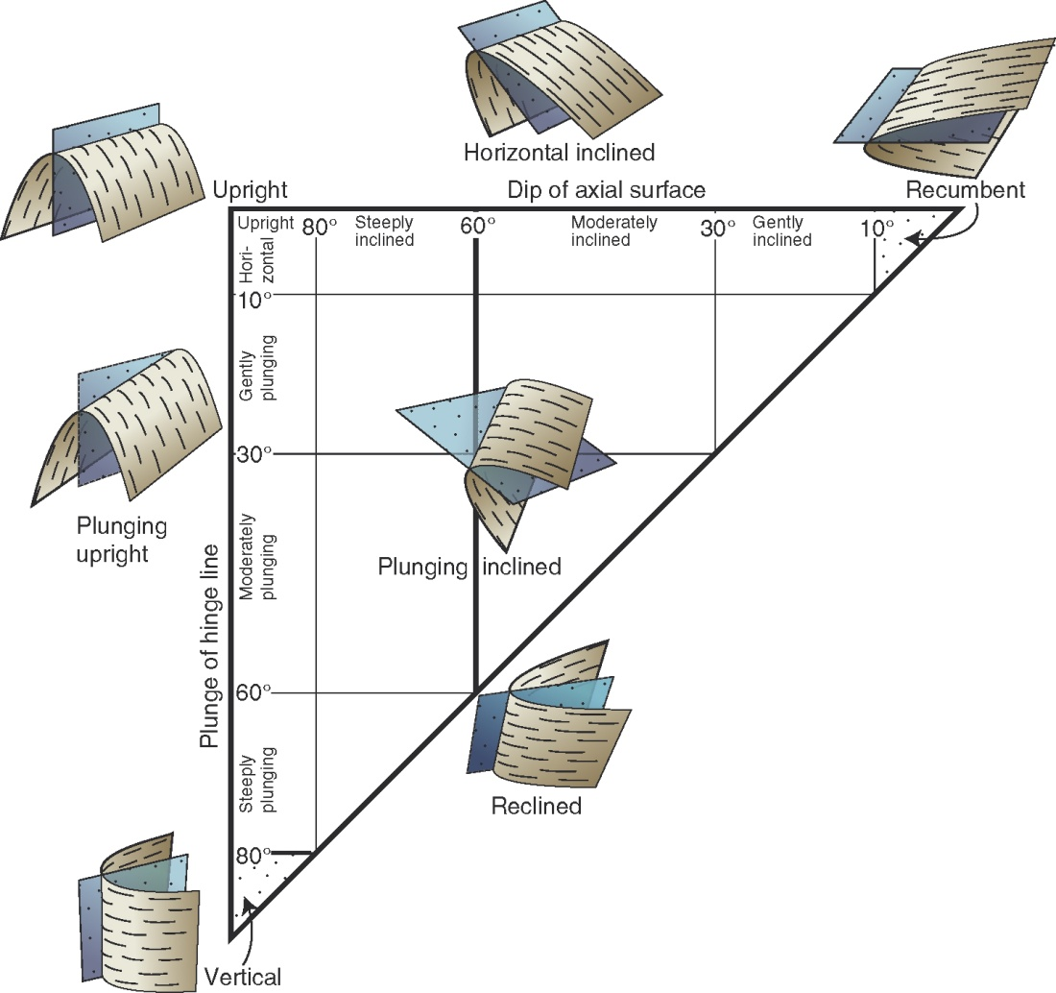
© Cambridge University Press 2011

Slide 9
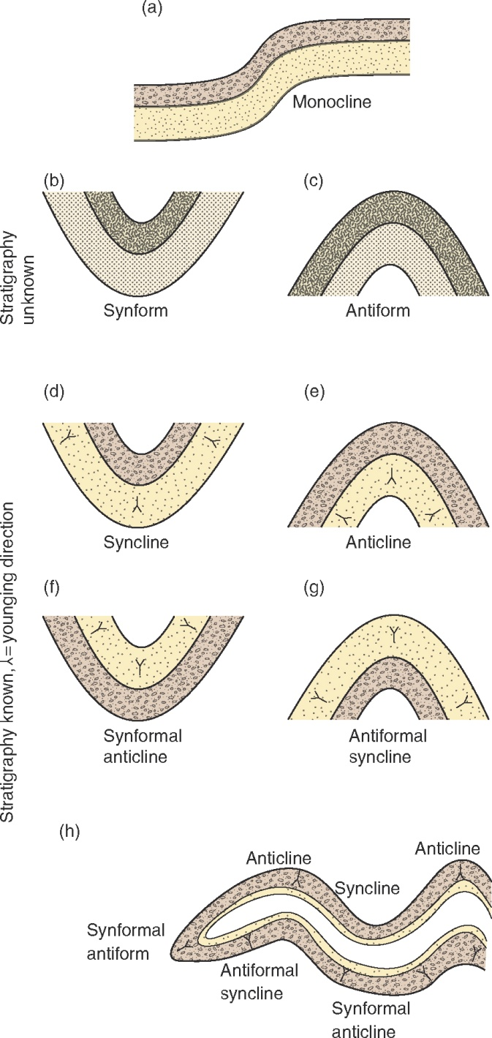
© Cambridge University Press 2011

Slide 10
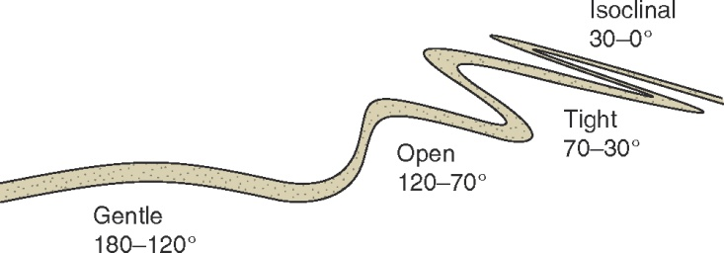
© Cambridge University Press 2011

Slide 11
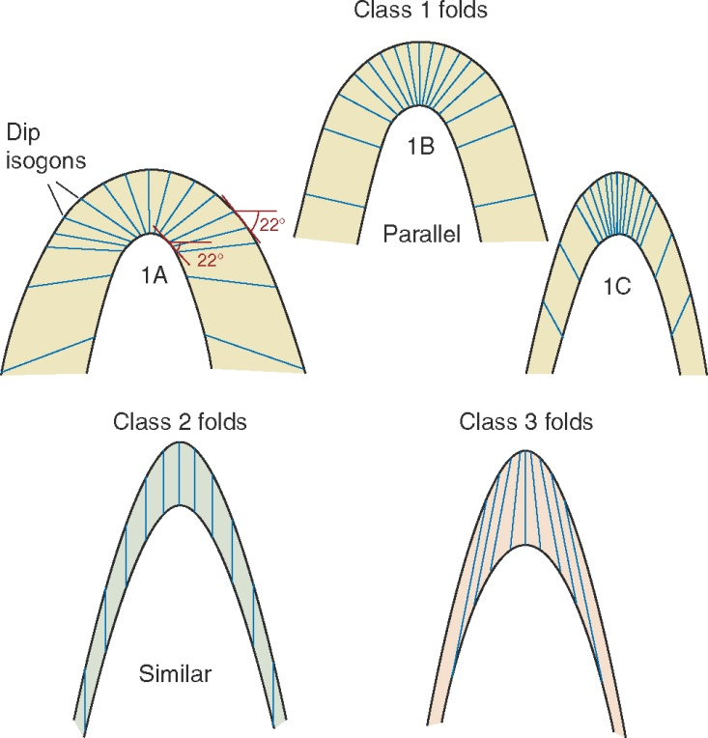
© Cambridge University Press 2011

Slide 12
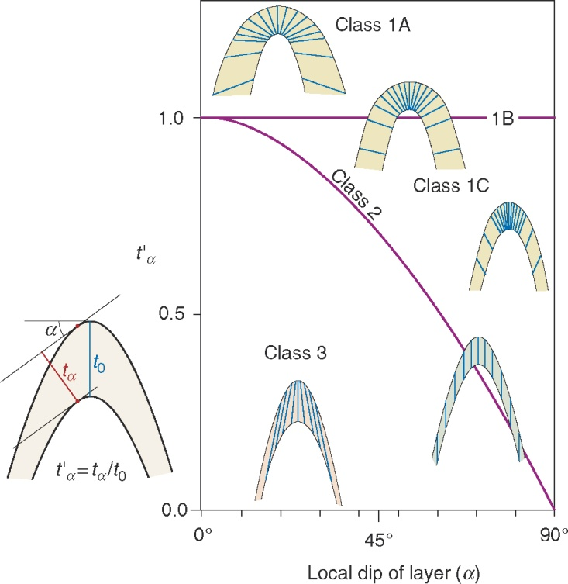
© Cambridge University Press 2011

Slide 13
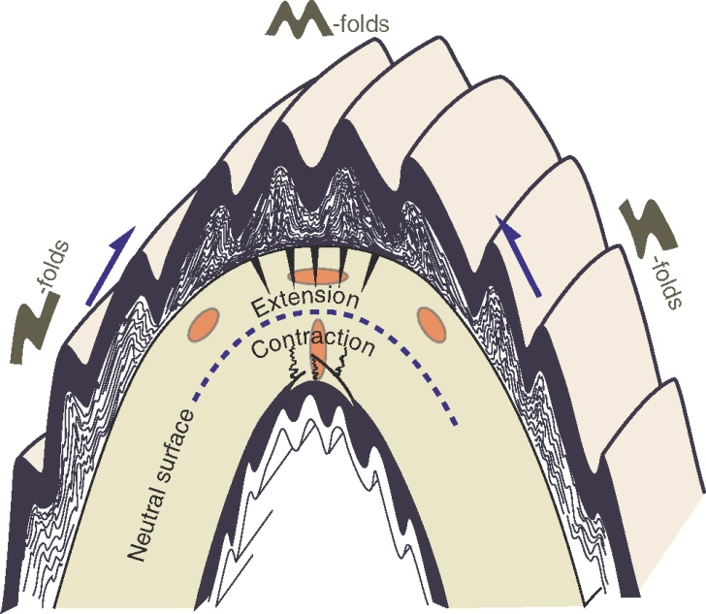
© Cambridge University Press 2011

Slide 14
© Cambridge University Press 2011

Slide 15
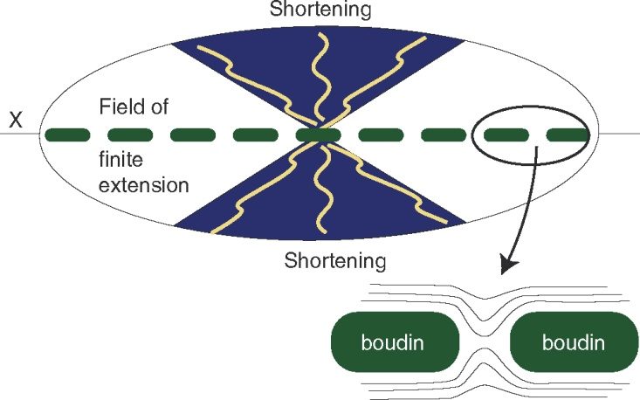
© Cambridge University Press 2011

Slide 16
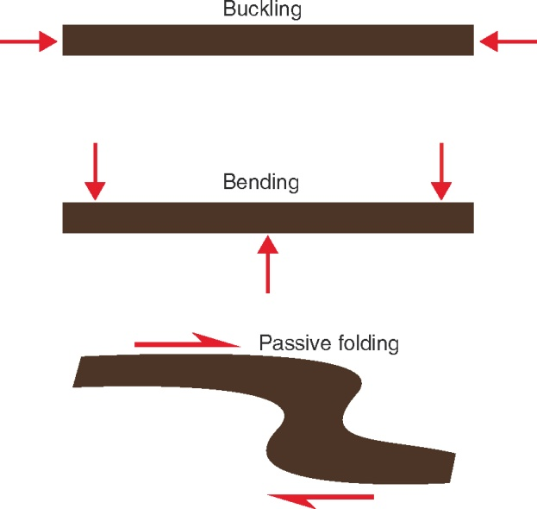
© Cambridge University Press 2011

Slide 17
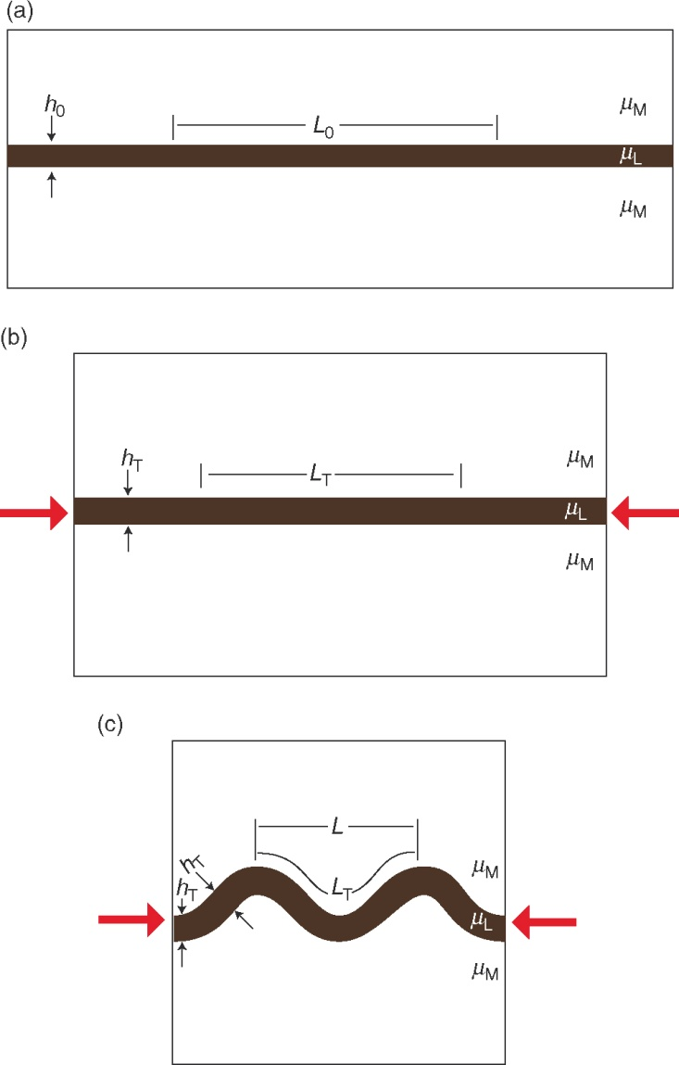
© Cambridge University Press 2011

Slide 18
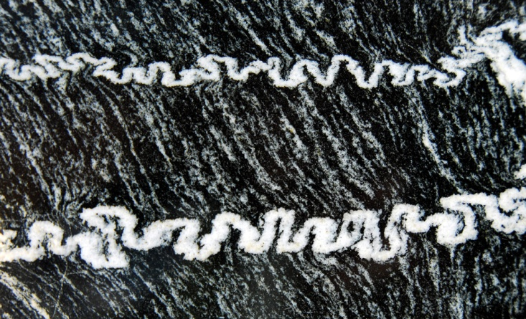
© Cambridge University Press 2011

Slide 19
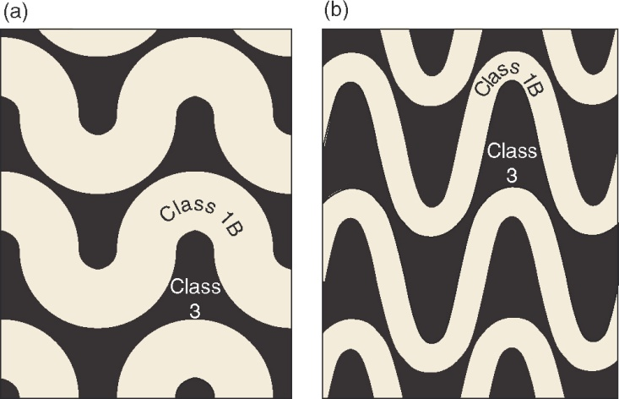
© Cambridge University Press 2011

Slide 20
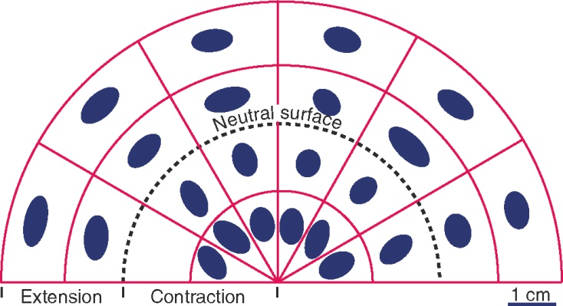
© Cambridge University Press 2011

Slide 21
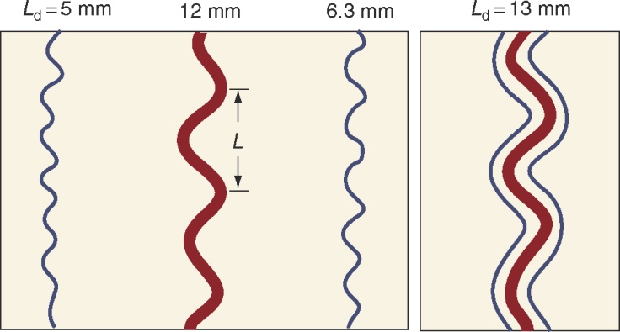
© Cambridge University Press 2011

Slide 22
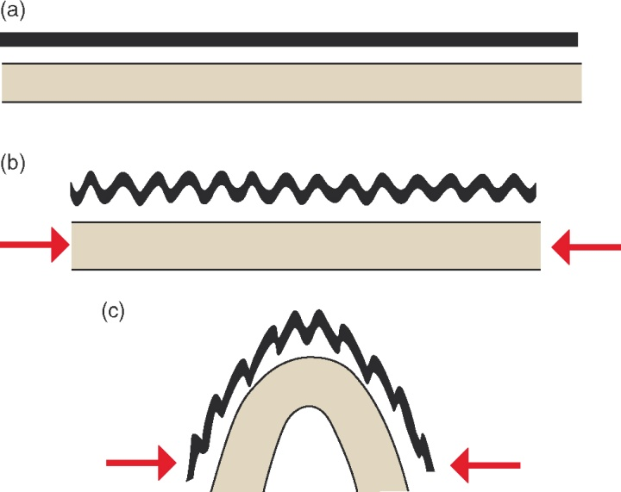
© Cambridge University Press 2011

Slide 23
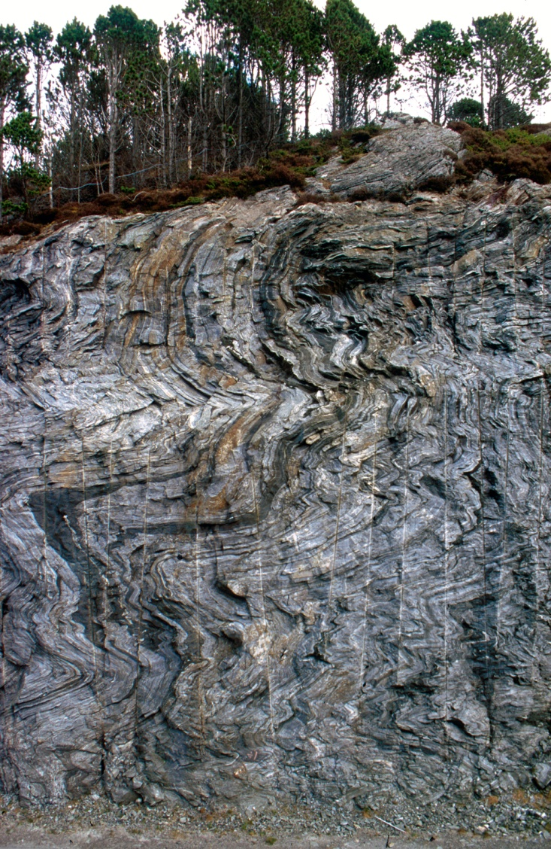
© Cambridge University Press 2011

Slide 24
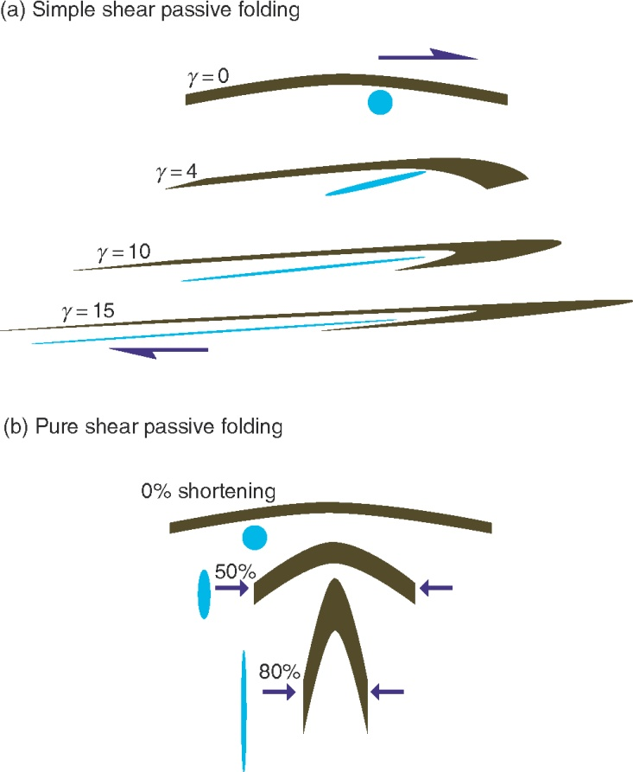
© Cambridge University Press 2011

Slide 25
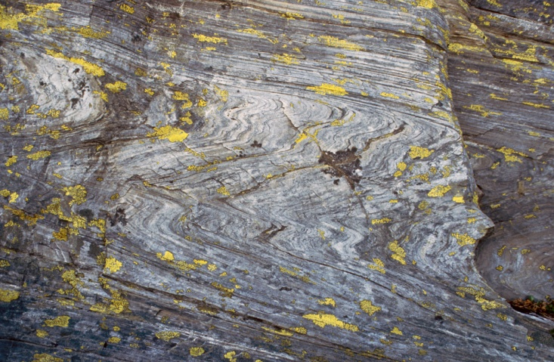
© Cambridge University Press 2011

Slide 26
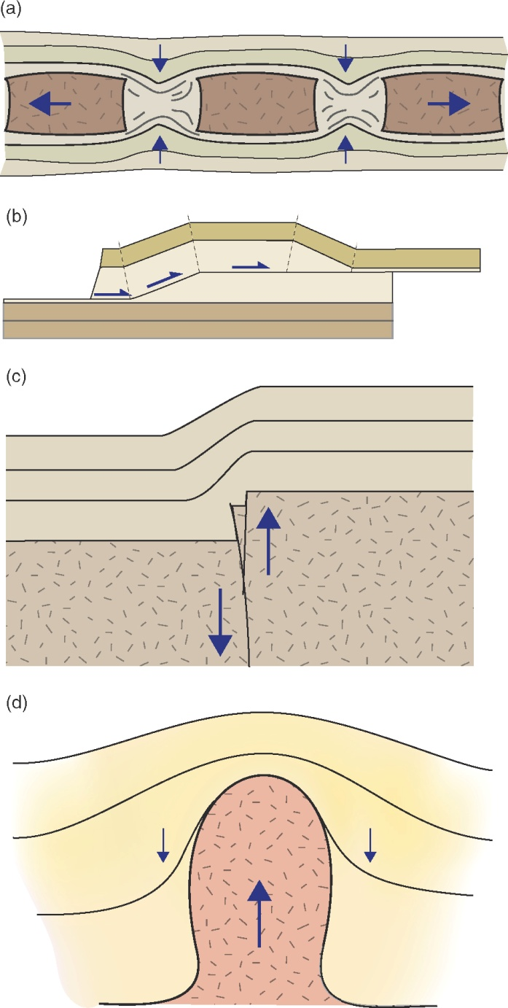
© Cambridge University Press 2011

Slide 27
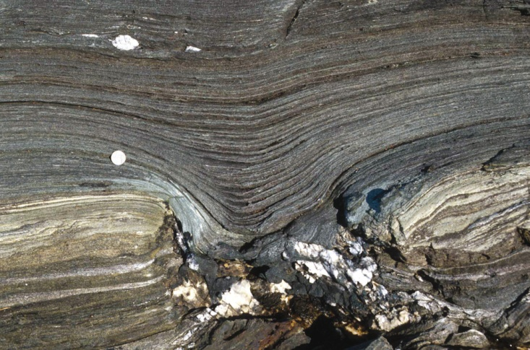
© Cambridge University Press 2011

Slide 28
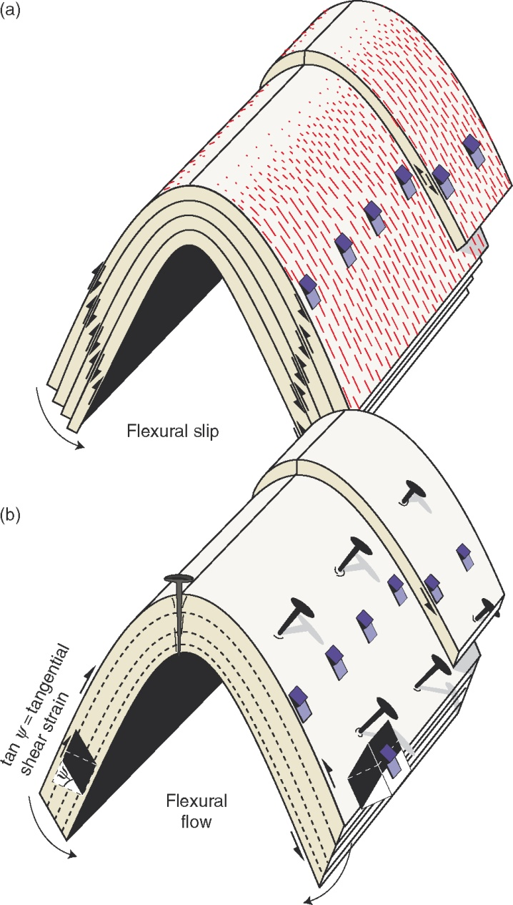
© Cambridge University Press 2011

Slide 29
© Cambridge University Press 2011

Slide 30
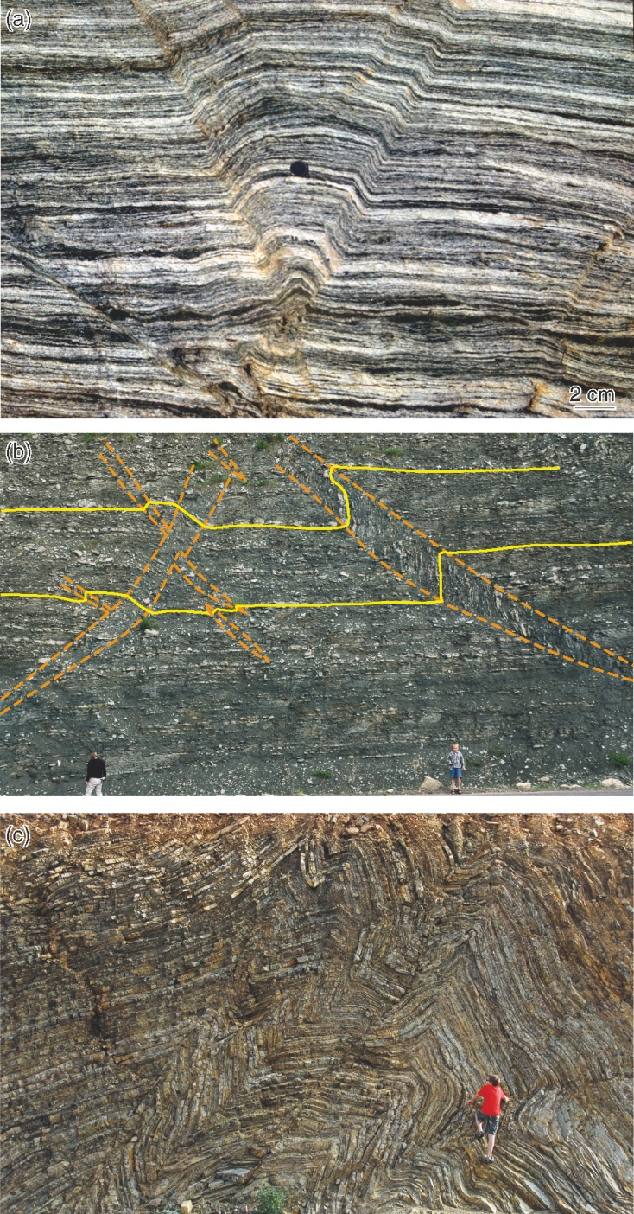
© Cambridge University Press 2011

Slide 31
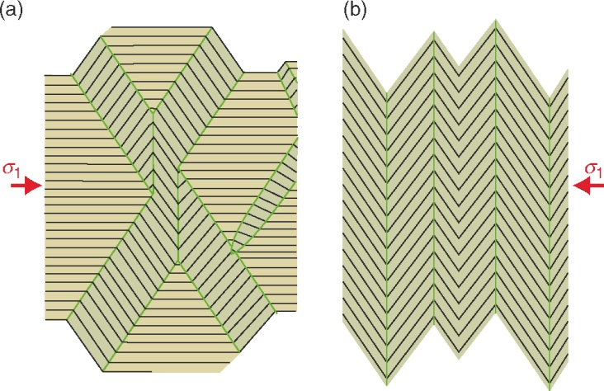
© Cambridge University Press 2011

Slide 32
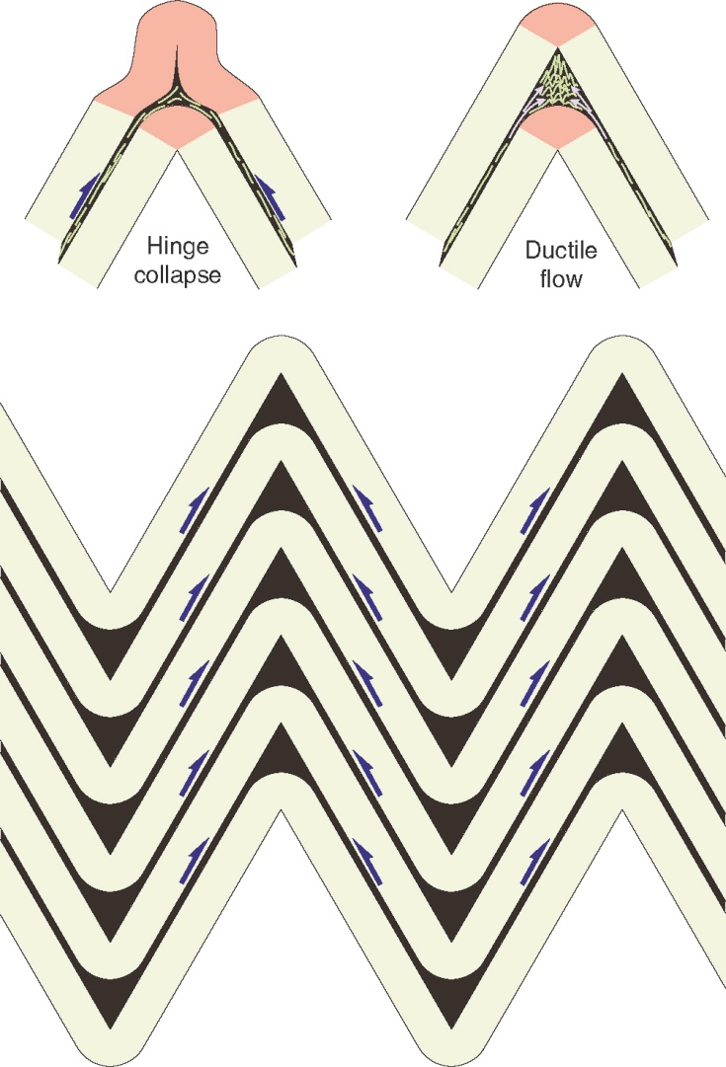
© Cambridge University Press 2011

Slide 33
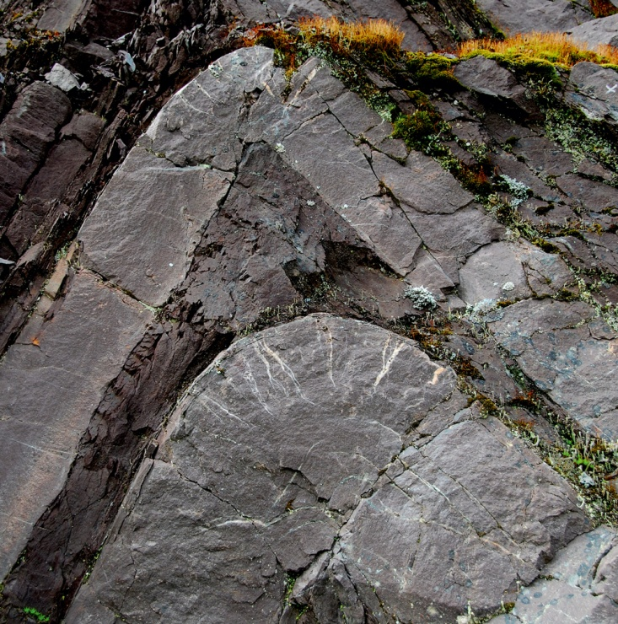
© Cambridge University Press 2011

Slide 34
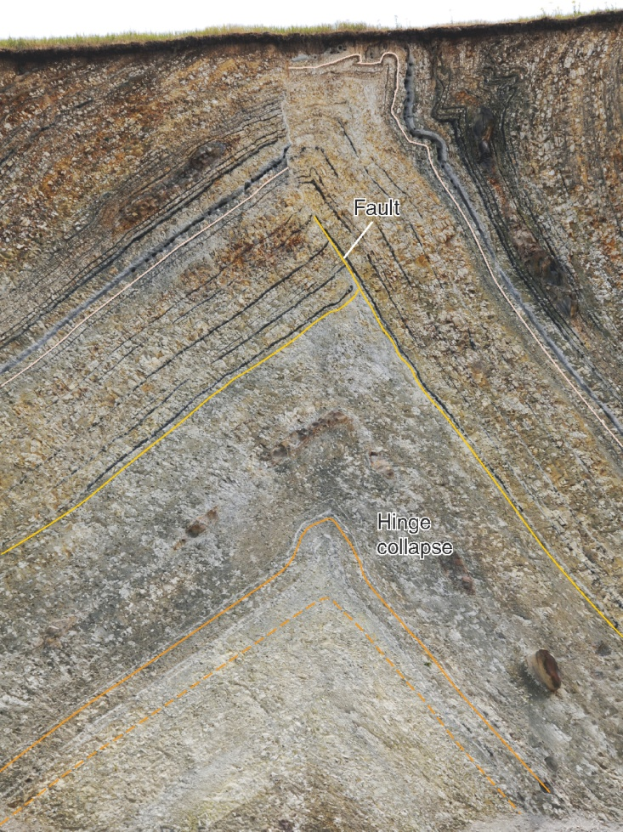
© Cambridge University Press 2011

Slide 35
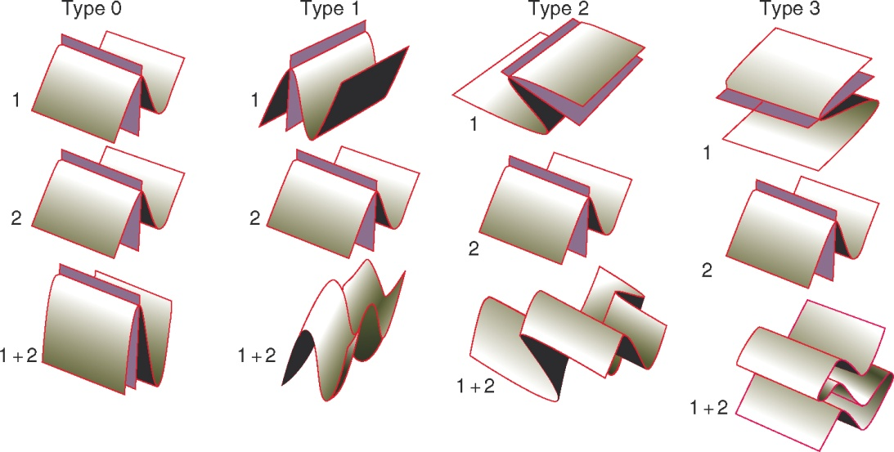
© Cambridge University Press 2011

Slide 36
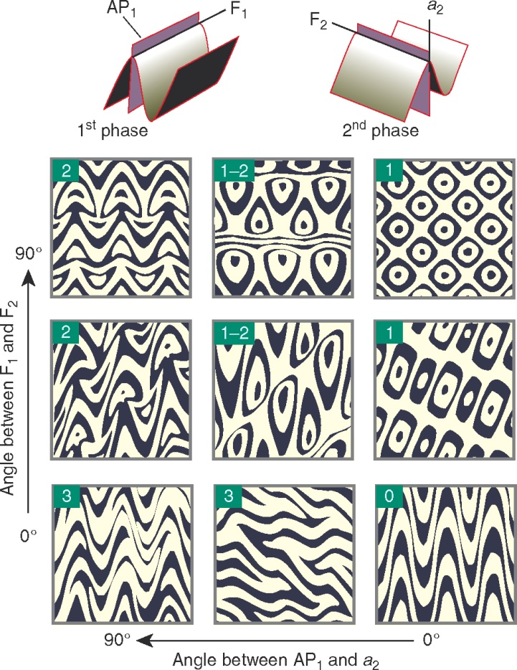
© Cambridge University Press 2011

Slide 37
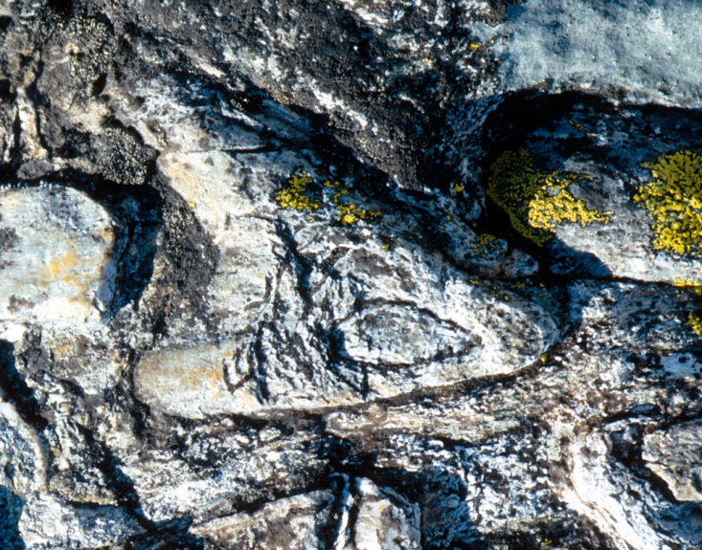
© Cambridge University Press 2011

Slide 38
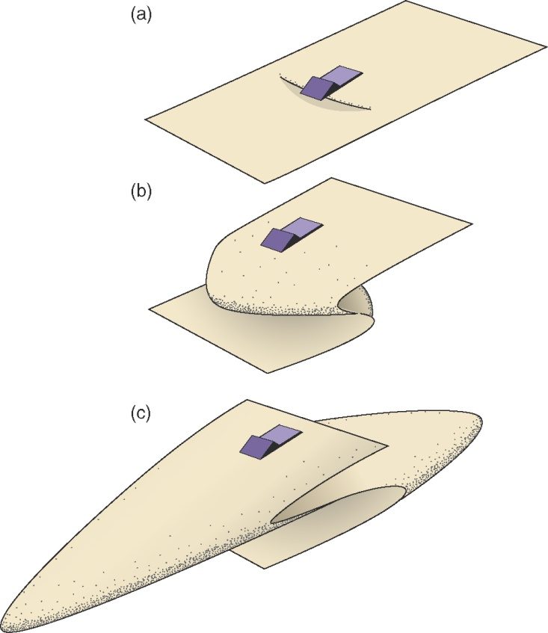
© Cambridge University Press 2011

Slide 39
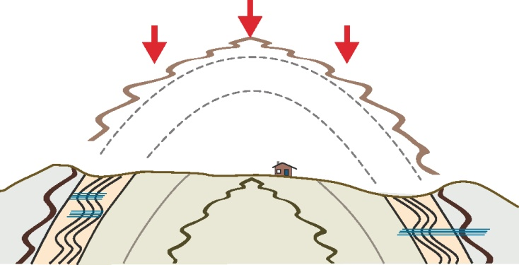
© Cambridge University Press 2011

Slide 40
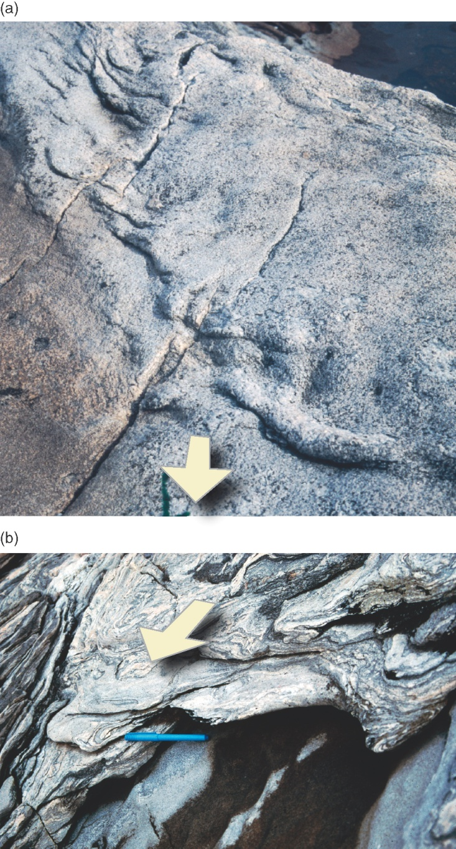
© Cambridge University Press 2011

Slide 41
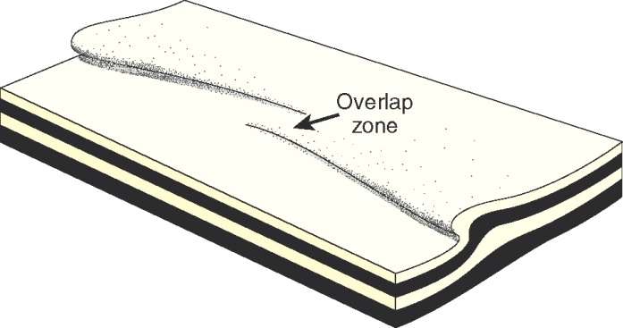
© Cambridge University Press 2011

Slide 42
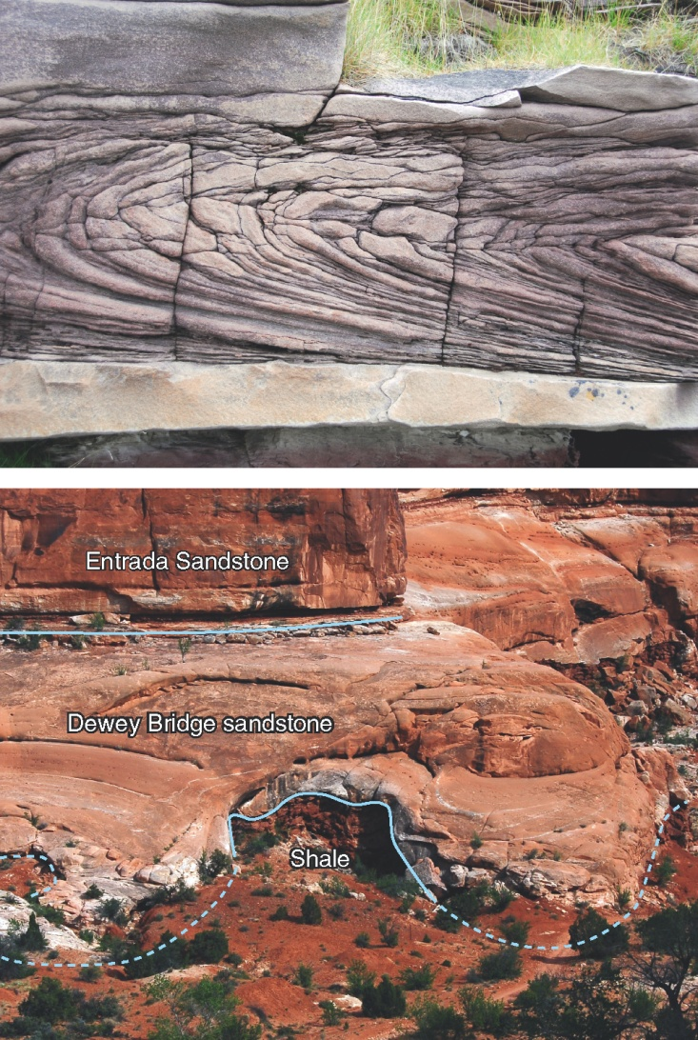
© Cambridge University Press 2011

