Slide 1
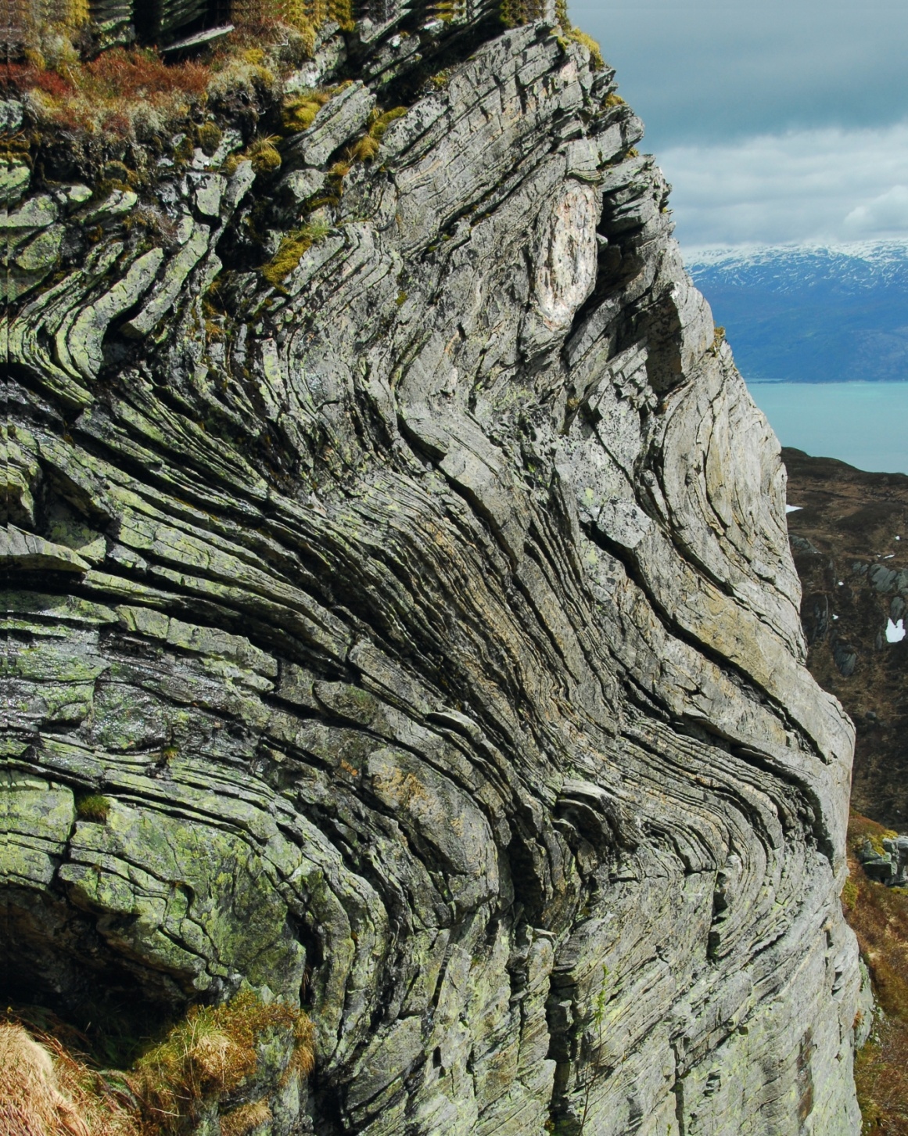
© Cambridge University Press 2011

Slide 2
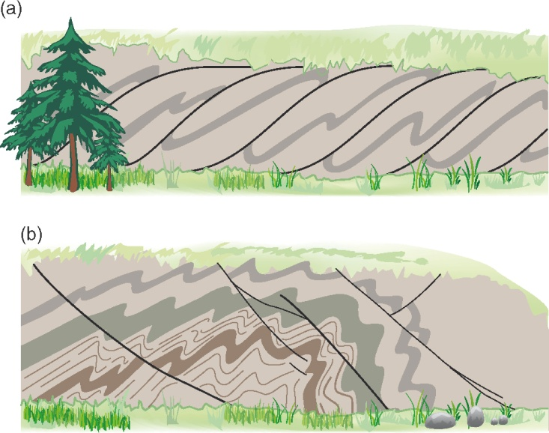
© Cambridge University Press 2011

Slide 3
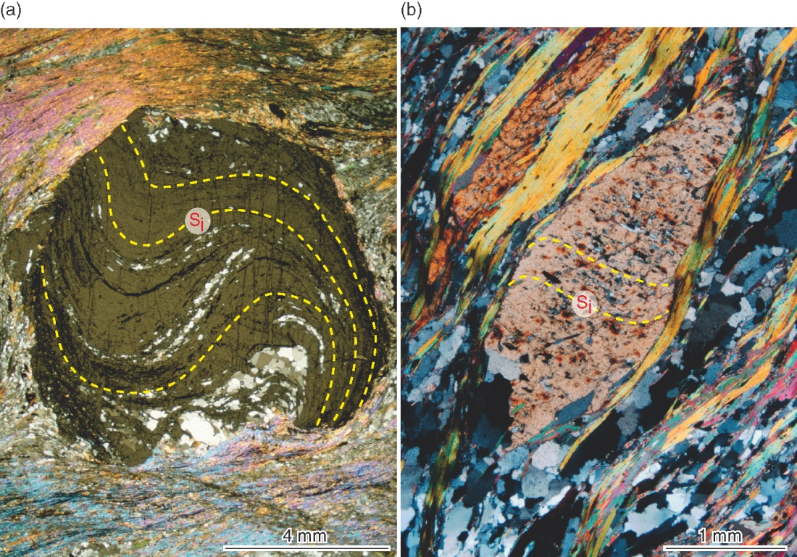
© Cambridge University Press 2011

Slide 4
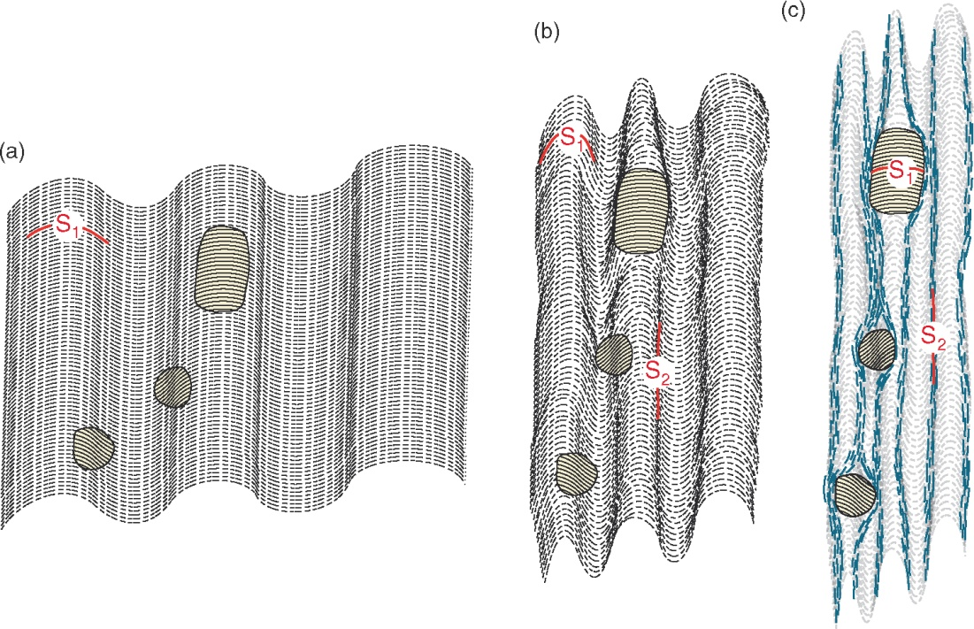
© Cambridge University Press 2011

Slide 5
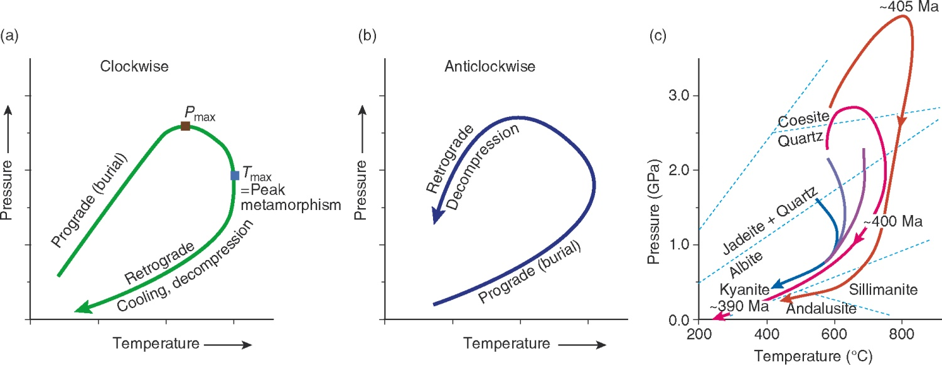
© Cambridge University Press 2011

Slide 6
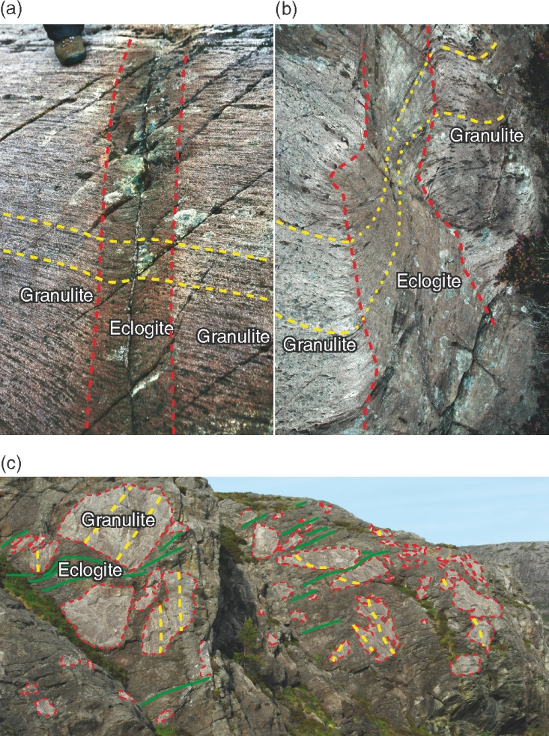
© Cambridge University Press 2011

Slide 7
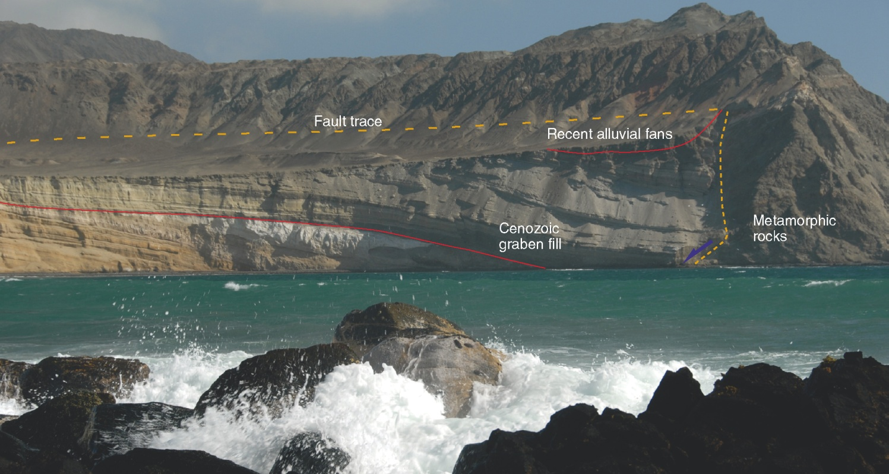
© Cambridge University Press 2011

Slide 8
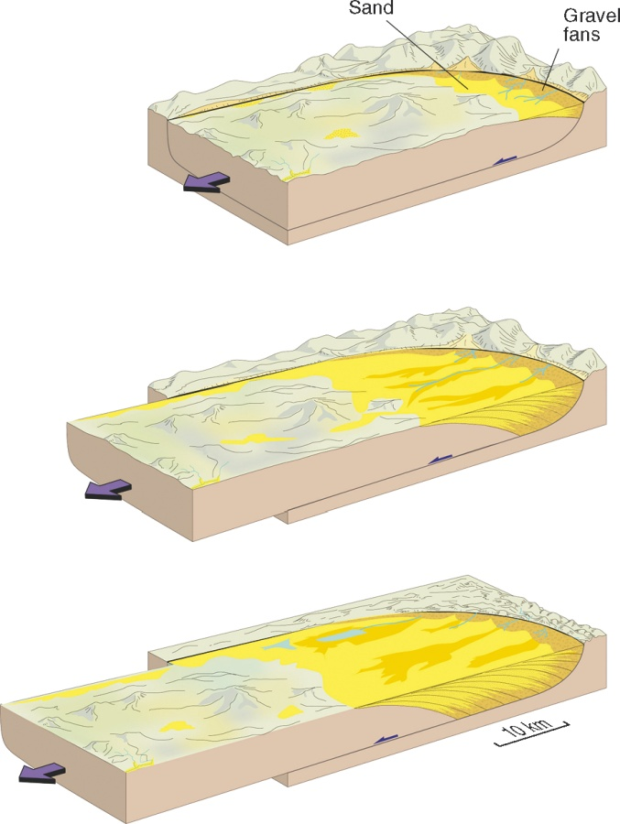
© Cambridge University Press 2011

Slide 9
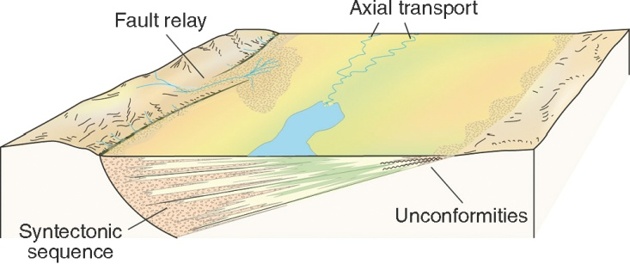
© Cambridge University Press 2011

